Slide 1
Code Generation

Slide 2
Structure of a Compiler
Source Language
Lexical Analyzer
Syntax Analyzer
Front
End
Semantic Analyzer
Int. Code Generator
Intermediate Code
Code Optimizer
Back
End
Target Code Generator
Target Language

Slide 3
Now!
Source Language
Lexical Analyzer
Front
End
Syntax Analyzer
Semantic Analyzer
Int. Code Generator
Intermediate Code
Code Optimizer
Back
End
Target Code Generator
Target Language

Slide 4
Intermediate Code Generation.
While translating a source program into a functionally equivalent object code representation, a parser may first generate an intermediate representation. This makes retargeting of the code possible and allows some optimization to be carried out that would otherwise not be possible.

Slide 5
Intermediate Code Generation.
The following are commonly used intermediate representations:
Postfix notation
Syntax tree
Three address code

Slide 6
Syntax Tree.
The syntax tree is nothing more than a condensed form of the parse tree. The operator and keyword nodes of the parse tree are moved to their parent, and a chain of single productions is replaced by single link.

Slide 7
Three Address Code.
Three address code is a sequence of statement of the form x = y op z. Since a statement involves no more than three references, it is called a “three address statement”, and a sequence of such statements is referred to as three address code.

Slide 8
Three Address Code(Cont’d)
For example, the three address code for the expression 2 * a + (b -3):
T1 = 2 * a
T2 = b - 3
T3 = T1 + T2

Slide 9
Three Address Code(Cont’d)
Sometimes a statement might contain less than three references; but it is still called a three address statement. The following are the three address statements used to represent various programming language constructs:

Slide 10
Three Address Code(Cont’d)
Used for representing arithmetic expressions:
X = Y op Z
X = op Y
X = Y

Slide 11
Three Address Code(Cont’d)
Used for representing Boolean expressions:
If A > B goto Z
goto Z

Slide 12
Representing Three Address Statements
Records with fields for the operators and operands can be used to represent three address statements. It is possible to use a record structure with four fields: the first holds the operator, the next two hold the operand1 and operand2, respectively, and the last one holds the result. This representation of a three address statement is called a “quadruple representation”.

Slide 13
Quadruple Representation
Using quadruple representation, the three address statement x = y op z is represented by placing op in the operator field, y in the operand1 field, z in the operand2 field, and x in the result field.The statement x = op y, where op is a unary operator, is represented by placing op in the operator field, y in the operand1 field, and x in the result field; the operand2 field is not used.

Slide 14
Quadruple Representation(Cont’d)
Unconditional and conditional jump statements are represented by placing the target labels in the result field.

Slide 15
Quadruple Representation(Cont’d)
For example, a quadruple representation of the three address code for the statement
x = (a + b) * - c / d
is shown in the table. The numbers in parentheses represent the pointers to the triple structure.

Slide 16
Example: x = (a + b) * - c / d
 | Operator | Operand 1 | Operand 2 | Result
(1) | + | a | b | t1
(2) | - | c |  | t2
(3) | * | t1 | t2 | t3
(4) | / | t3 | d | t4
(5) | = | t4 |  | x

Slide 17
Triple Representation.
The contents of the operand1, operand2 and the result fields are therefore normally the pointers to the symbol records for the names represented by these fields. Hence, it becomes necessary to enter temporary names into the symbol table as they are created. This can be avoided by using the position of the statement to refer to a temporary value.

Slide 18
Triple Representation(Cont’d)
If this is done, then a record structure with three fields is enough to represent the three address statements: the first holds the operator value, and the next two holding values for the operand1 and the operand2,respectively. Such a representation is called a “triple representation”.

Slide 19
Triple Representation(Cont’d)
The contents of the operand1 and operand2 fields are either pointers to the symbol table records, or they are pointers to records (for temporary names) within the triple representation itself.
For example, a triple representation of the three address code for the statement,
x = (a + b) * - c / d
is shown in the table.

Slide 20
Example: x = (a + b) * - c / d
 | Operator | Operand 1 | Operand 2
(1) | + | a | b
(2) | - | c
(3) | * | (1) | (2)
(4) | / | (3) | d
(5) | = | x | (4)

Slide 21
Example No.1
if (a < b )
X = Y + Z
else
P = Q + R
Write three address code for the above program?

Slide 22
Example No.1(Solution)
0) if a < b goto(2)
1) goto (5)
2) t1 = y + z
3) x = t1
4) goto (7)( end or exit)
5) t2 = q + r
6) p = t2
7) End

Slide 23
Example No.2
For (i =1; i<=10; i++)
x = y + z
Write three address code for the above program?

Slide 24
Example No.2(Solution)
0) i =1
1) if i <= 10 goto(6)
2) goto (9) (End or Exit)
3) t1= i +1 (i = i +1)
4) i = t1
5) goto (1)
6) t2 = y + z
7) x = t2
8) goto (3)
9) End

Slide 25

Intermediate Code as Synthesized Attribute.

Slide 26
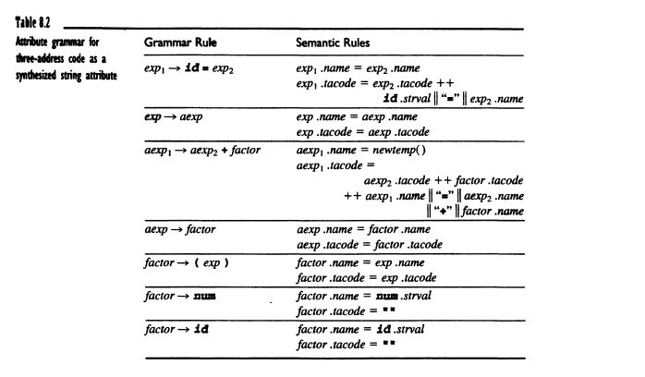

Slide 27

Code Optimization

Slide 28
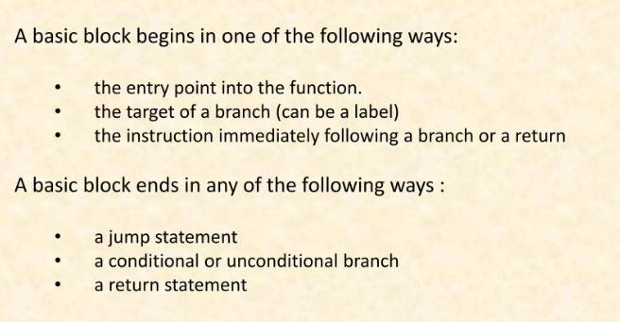

Slide 29
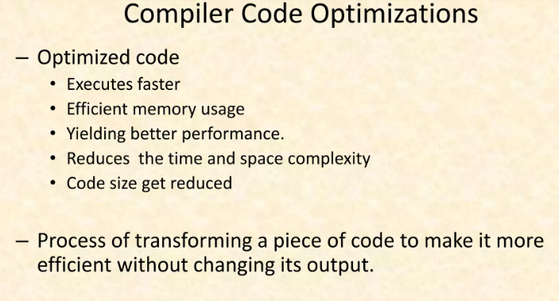

Slide 30
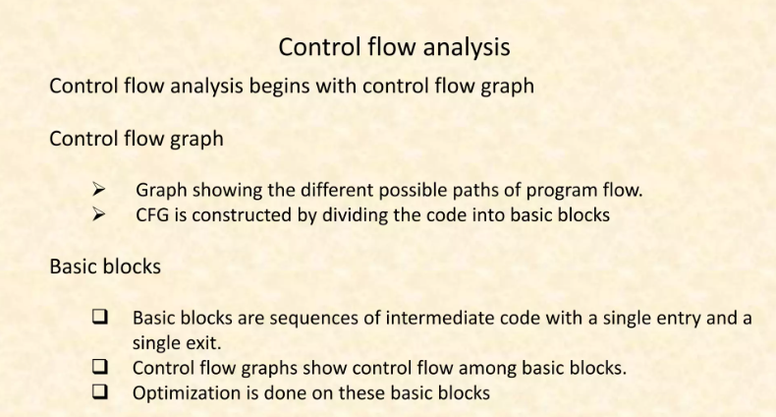

Slide 31
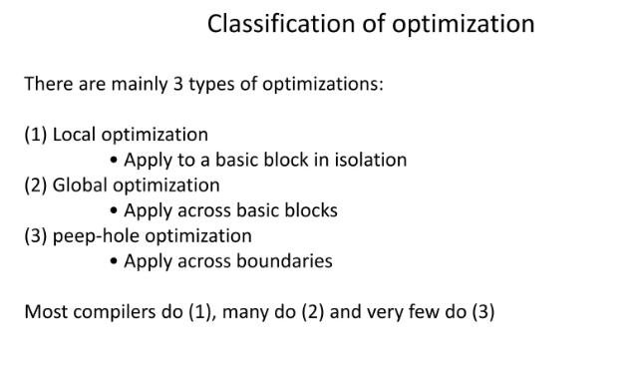

Slide 32
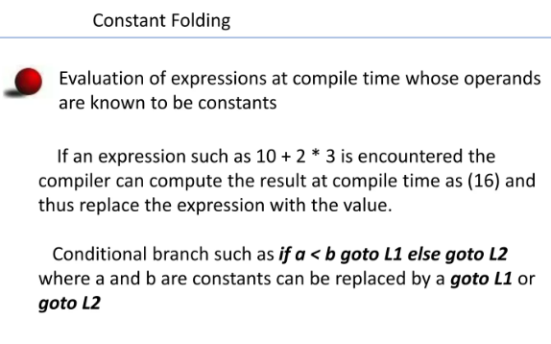

Slide 33
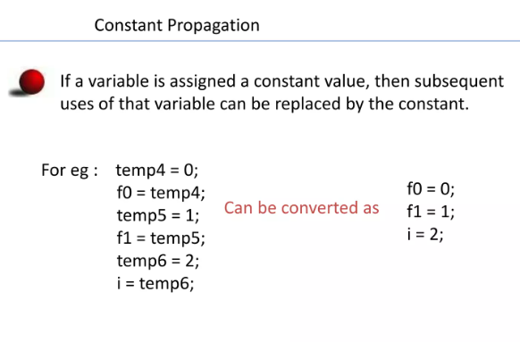

Slide 34
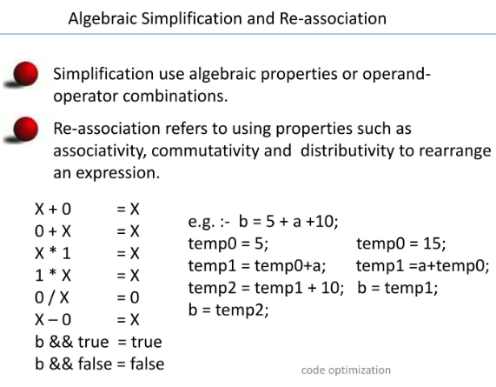

Slide 35
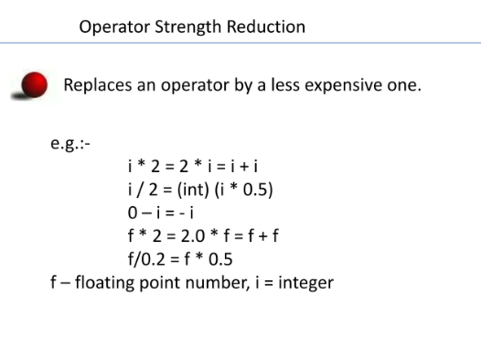

Slide 36
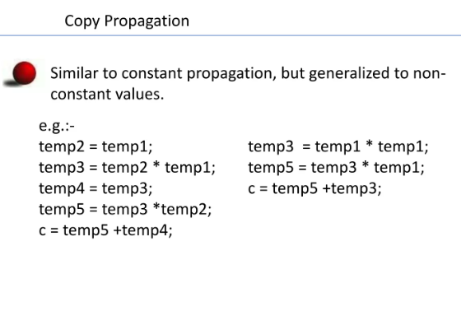

Slide 37
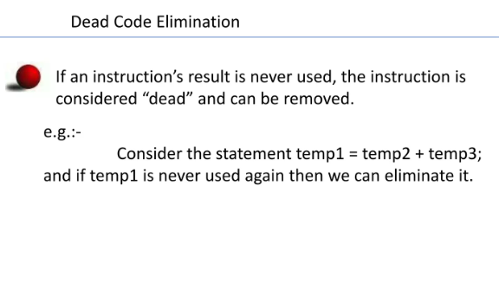

Slide 38
Tail recursion elimination
Tail recursion elimination is a code optimization technique where recursive calls are transformed into iterative loops. This optimization is particularly effective when the recursive call is the last action performed in a function (a tail call), as it allows the compiler to reuse the same stack frame instead of creating new ones for each call.

Slide 39
Loop optimization
Loop Optimization is the process of increasing execution speed and reducing the overheads associated with loops. It plays an important role in improving cache performance and making effective use of parallel processing capabilities. Most execution time of a scientific program is spent on loops.

Slide 40
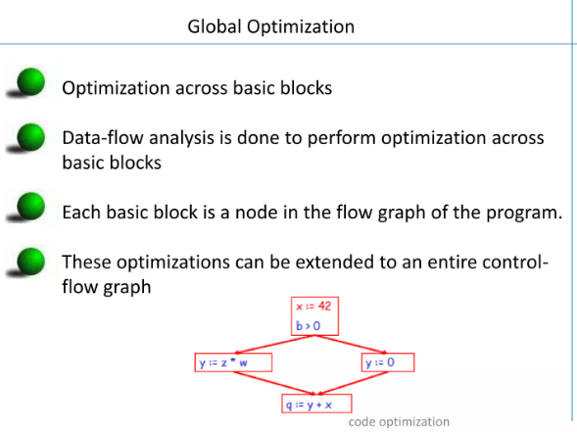

Slide 41
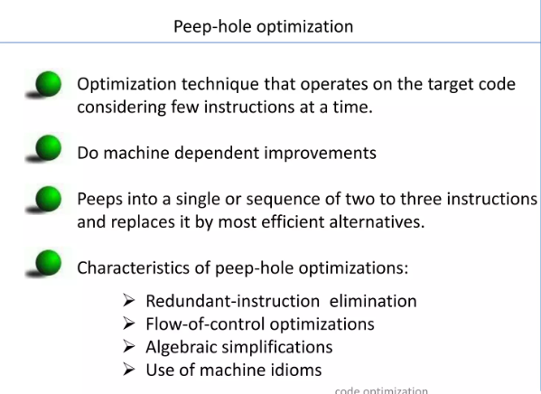

Slide 42
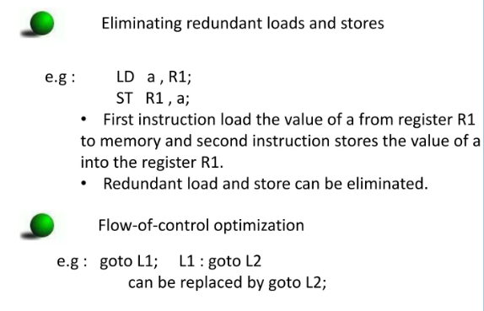

Slide 43
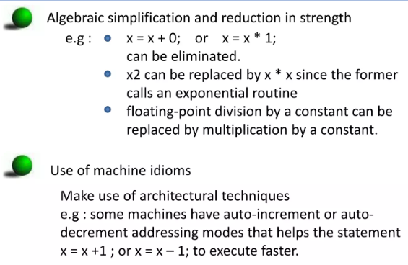

Slide 44
Quiz
Question 1) Show the activation records in the Data stack if bar (10) is called ?
int bar(int x) { return x + 1; }
int foo(int y)
{ int f= 30; int d=5 ;
return bar(y * 2); }
int main()
{ int z = foo(5); return 0; }
Question 2)
int fibonacci(int n) { int a, b; if (n <= 1) return n;
a = fibonacci(n - 1);
b = fibonacci(n - 2);
return a + b; }
int main() { int x = fibonacci(9); return 0; }
Make the activation tree for Fibonacci(9).

